Slide 1



An Introduction to Statistical Learning
with Applications in R
Gareth James • Daniela Witten • Trevor Hastie • Robert Tibshirani

Slide 2
Agenda
Introductions
The book
Objectives
Basic rules
Guidelines/Logistics
Schedule
Chapter 1: Introduction
Tutorial: Creating and publishing presentations with R Studio

Slide 3

Introductions
Who are you?
Why are you here?
What are your expectations?

Slide 4
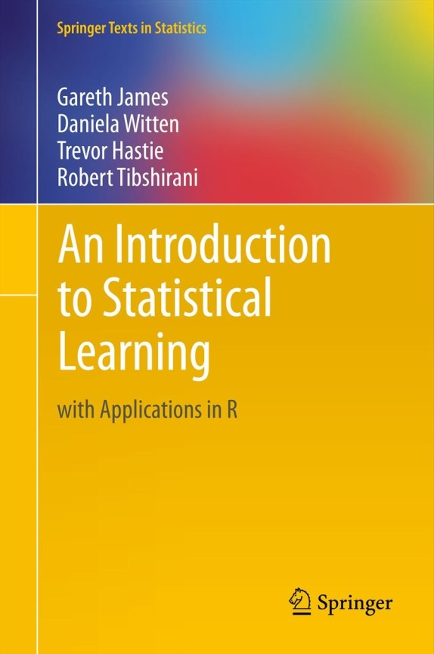
The Book
An Introduction to Statistical Learning with Applications in R
Available at: http://www-bcf.usc.edu/~gareth/ISL/book.html
“to facilitate the transition of statistical learning from an academic to a ainstream
Field”

Slide 5
Objectives
Collaboratively discuss about statistical methods for analyzing data
Collaborate with our fellows to better understand statistical concepts and its applications
To get hands-on experience on statistical analysis by following the labs in the book
To create a core team of data scientists
Any other?

Slide 6
Basic rules
To make this club a success we ALL need to collaborate
Commit to lead at least two sessions.
If you have questions, ask!
If you know the answers, share them!
If you cite copyrighted material, please appropriately reference your source(s). Also, please don't inappropriately post or distribute copyrighted material.

Slide 7
Guidelines/Logistics (1)
Meeting time:
When: Fridays 12:00 PM to 1:00 PM
Where:
Web: http://www.tinyurl.com/predictionhangout
Dial-in: 401-283-4363 * PIN 60382
In-person: Silberman 518

Slide 8
Guidelines/Logistics (2)
Communications:
Google group:
Intro Stat Learning book club
Stat_learning+noreply@googlegroups.com
Sharing code, outputs:
GitHub
https://github.com/jsrodriguezl/Book_Club
Sharing documents for review:
Google Drive:
https://drive.google.com/folderview?id=0B37LTUTfIpszWHJxVVNOVHNKVUU&usp=sharing

Slide 9
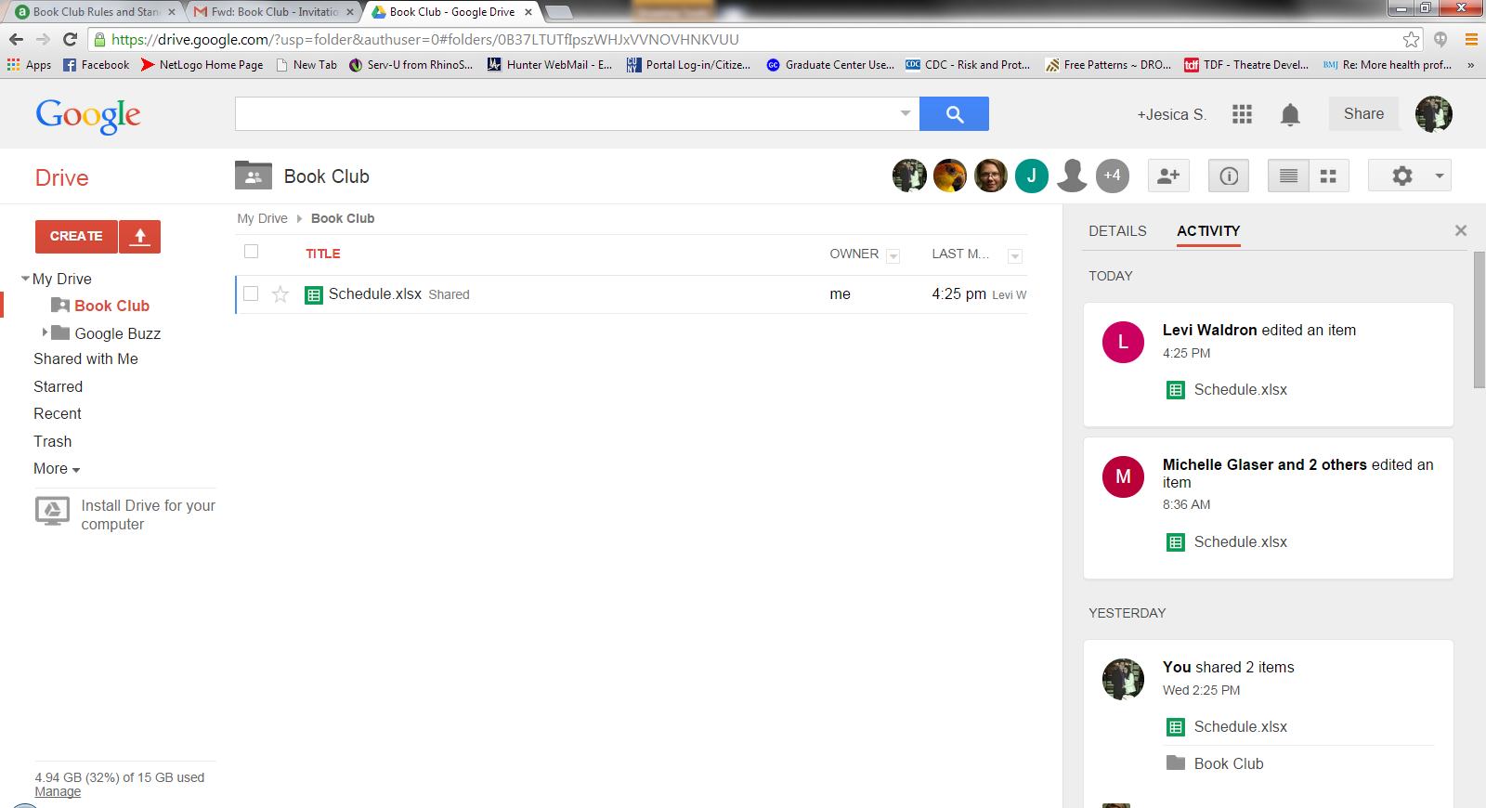
Schedule
https://docs.google.com/spreadsheets/d/183WX8qxeHmfmSyiVuYn5V38P_zYuwtd66SmdMPNp9CQ/edit#gid=1037464231

Slide 10

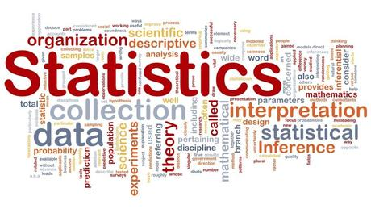
Chapter 1: Introduction

Slide 11
Tools for understanding data
Supervised:
Building statistical models
Predicting
Estimating
Outputs based on inputs
Unsupervised
No expected outputs
Learn relationships and structure about inputs

Slide 12
History (1)
Beginning of 19th century - Legendre and Gauss: Method of least squats (Linear Regression) – Predicting quantitative values
1936 - Fisher: Linear discriminant analysis – Predicting qualitative values
1940: Logistic regression – Predicting qualitative values
1970 - Nelder and Wedderburn: Generalized linear models - Predicting qualitative and qualitative values

Slide 13
History (2)
1980s - Breiman, Friedman, Olshen and Stone: classification and regression trees (non-linear relationships)
1986 - Hastie and Tibshirani: generalized additive models (non-linear extensions to generalized linear models)
More recently: machine learning

Slide 14
Datasets (1)
Wage Data:
Source: Data from group of males from the Atlantic region of the United States
Variables: Wages, age, year of wage, and education.
Aim: understand the association between an employee’s wage and age, year of wage, and education
Stock Market Data
Source: Data from the daily movements in the Standard & Poor’s 500 (S&P) stock index over a 5-year period between 2001 and 2005.
Variables: Daily Index, time variable
Aim: to predict whether the index will increase or decrease on a given day using the past 5 days’ percentage changes in the index.

Slide 15
Datasets (2)
Gene Expression Data
Source: 6830 gene expression measurements for each of 64 cancer cell lines
Aim: determining whether there are groups, or clusters, among the cell lines based on their gene expression measurements

Slide 16
Tutorial: Creating and publishing presentations with R Studio

